Slide 1
Introduction to Java

Slide 2
Language Basics

Slide 3
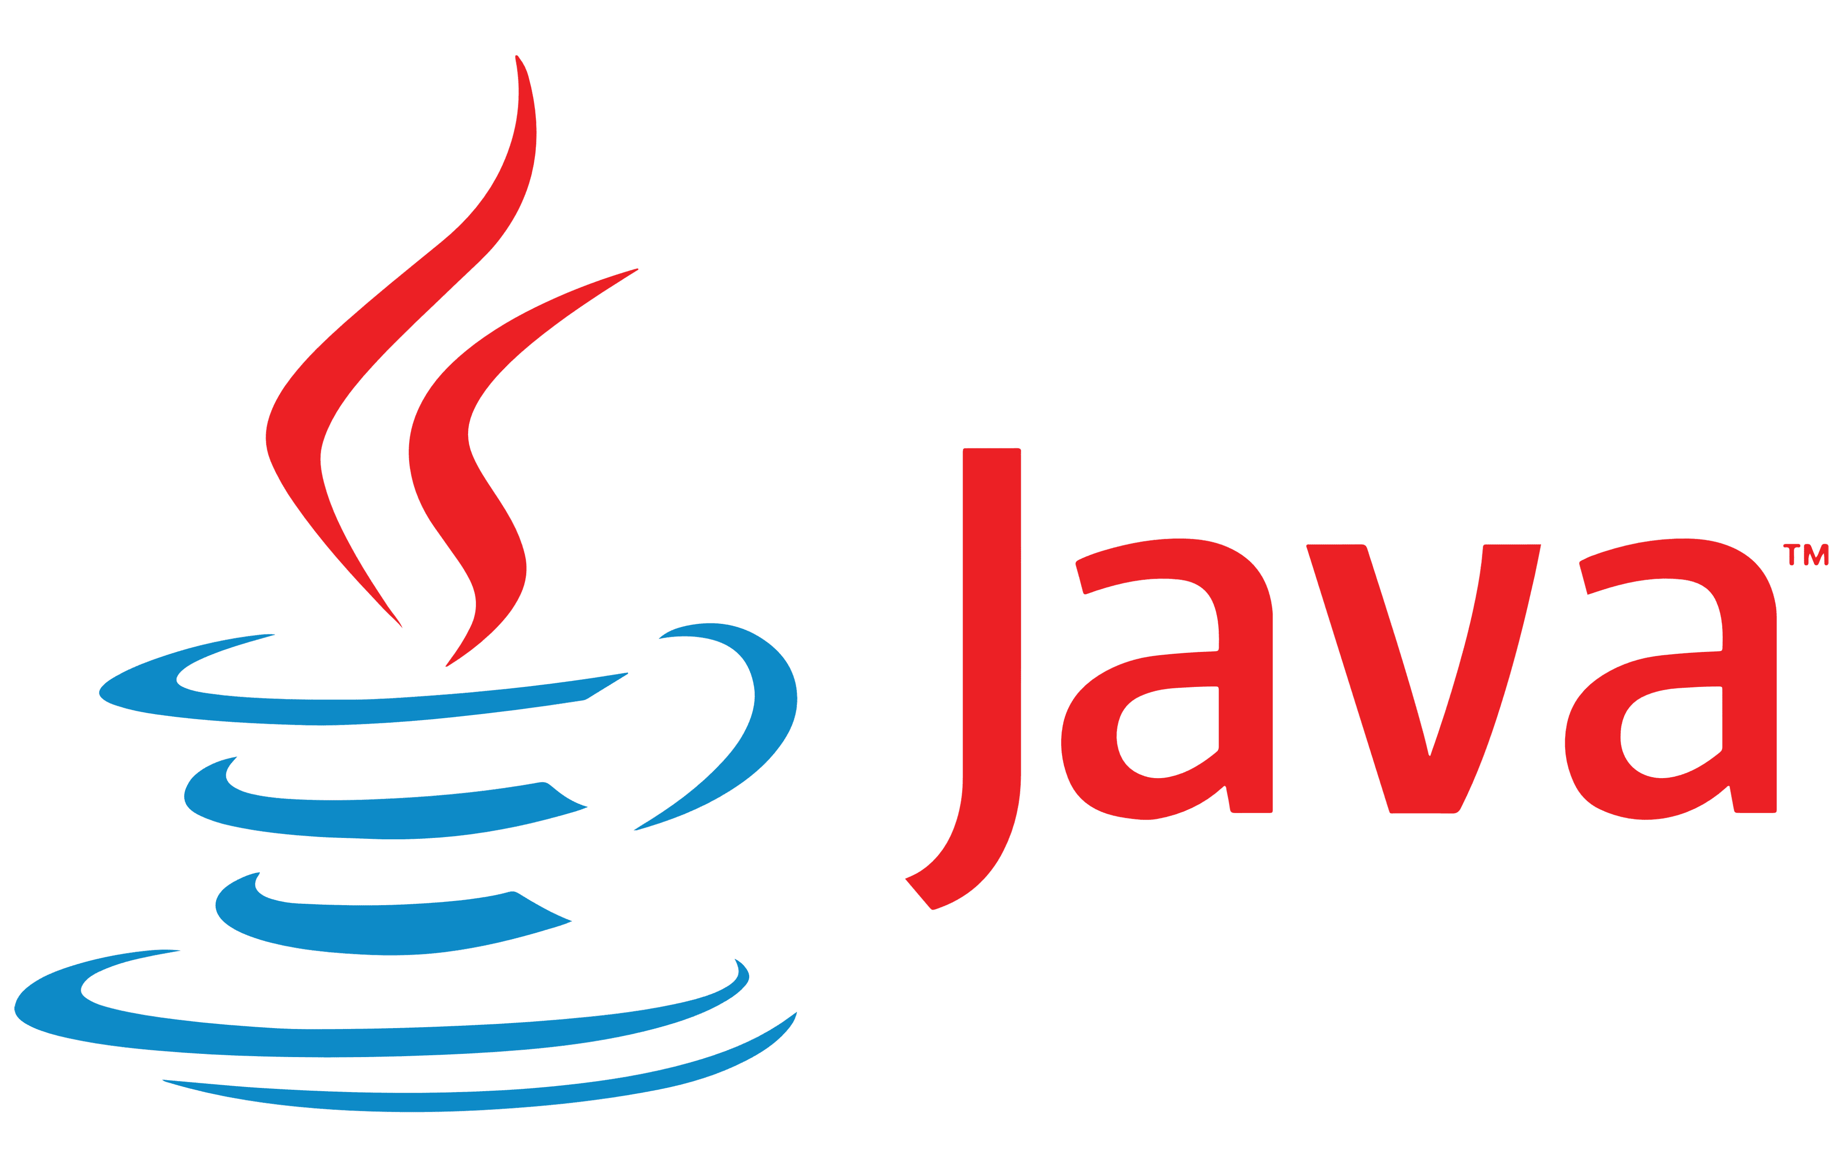
High-level, class-based, object-oriented programming language

Slide 4
History of Java
James Gosling, Mike Sheridan, and Patrick Naughton initiated the Java language project in June 1991. The small team of sun engineers called Green Team.
Initially it was designed for small, embedded systems in electronic appliances like set-top boxes.
Firstly, it was called "Greentalk" by James Gosling, and the file extension was .gt.
After that, it was called Oak and was developed as a part of the Green project.
Why Oak? Oak is a symbol of strength and chosen as a national tree of many countries like the U.S.A., France, Germany, Romania, etc.
Java is an island in Indonesia where the first coffee was produced (called Java coffee). It is a kind of espresso bean. Java name was chosen by James Gosling while having a cup of coffee nearby his office.
Initially developed by James Gosling at Sun Microsystems (which is now a subsidiary of Oracle Corporation) and released in 1995.
JDK 1.0 was released on January 23, 1996.
Java SE 18 (released at March 2022).

Slide 5
Topics
01
02
Variables
Operators
03
04
Expressions, Statements and Blocks
Control Flow Statements

Slide 6
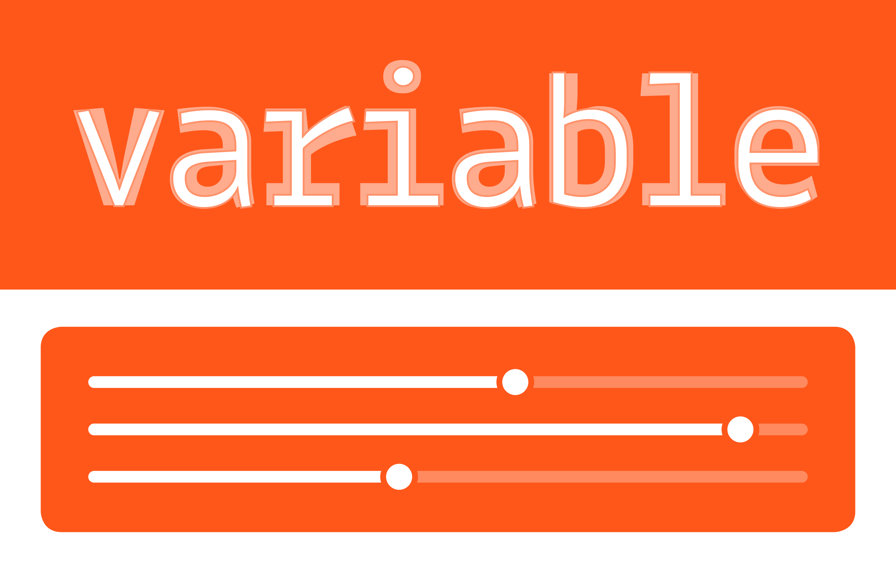
Variables
Instance Variables (Non-Static Fields)
Local Variables
Objects store their individual states in "non-static fields" (also known as instance variables). Because their values are unique to each instance of a class.
A method will often store its temporary state in local variables. The syntax for declaring a local variable is like declaring a field (for example, int count = 0;)
Class Variables (Static Fields)
Parameters
A class variable means there is exactly one copy of this variable in existence, regardless of how many times the class has been instantiated.
The signature for the main method is public static void main(String[] args). Here, the args variable is the parameter to this method.

Slide 7
Primitive Data Types
Kinds of values that can be stored and manipulated
Boolean: Truth value (true or false).
Byte
Short
Char
int: Integer (0, 1, -47).
Float
Long
double: Real number (3.14, 1.0, -2.1).
String: Text (“hello”, “example”)

Slide 8
Declaring Primitives
boolean myBooleanPrimitive;
byte b;
int x, y, z; // declare three int primitives
Literal Values for All Primitive Types:
'b' // char literal
42 // int literal
false // boolean literal
2546789.343 // double literal
boolean t = true; // Legal
boolean f = 0; // Compiler error!

Slide 9
Declaring Primitives
Decimal Literals:
Hexadecimal Literals:
int length = 343;
int y = 0x7fffffff;
int z = 0xDeadCafe;
Octal Literals:
int seven = 07; // Equal to decimal 7
int eight = 010; // Equal to decimal 8
int nine = 011; // Equal to decimal 9
double d = 11301874.9881024;
float g = 49837849.029847F;
float g = 49837849.029847f;
int length = 343;
long jo = 110599L;
long so = 0xFFFFl; // Note the lowercase 'l'

Slide 10
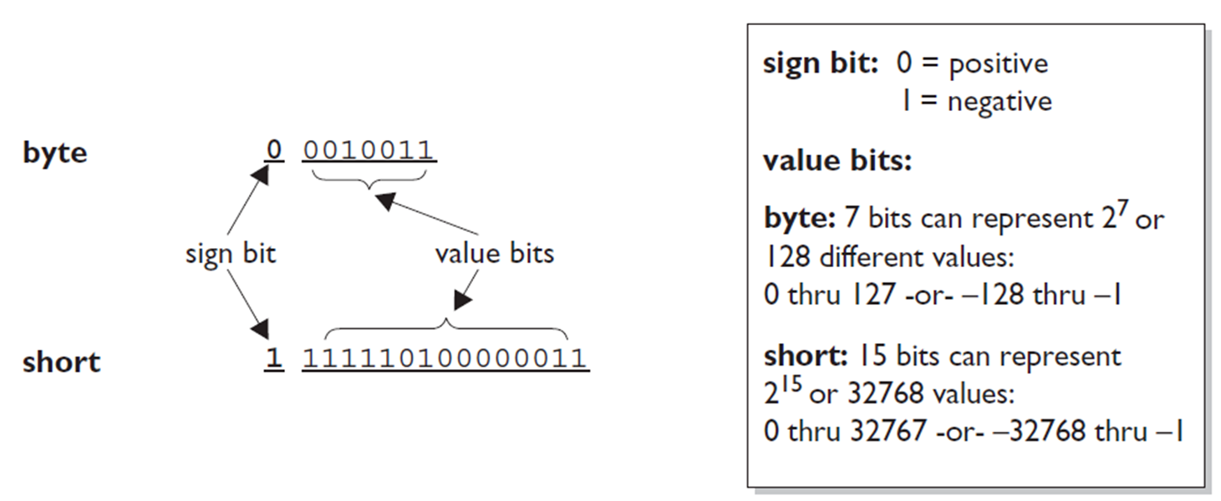
Primitive Ranges
All six number types made up of a certain number of 8-bit bytes, and are signed or unsigned, meaning they can be negative or positive.
The leftmost bit (the most significant digit) is used to represent the sign, where a 1 means negative and 0 means positive.

Slide 11
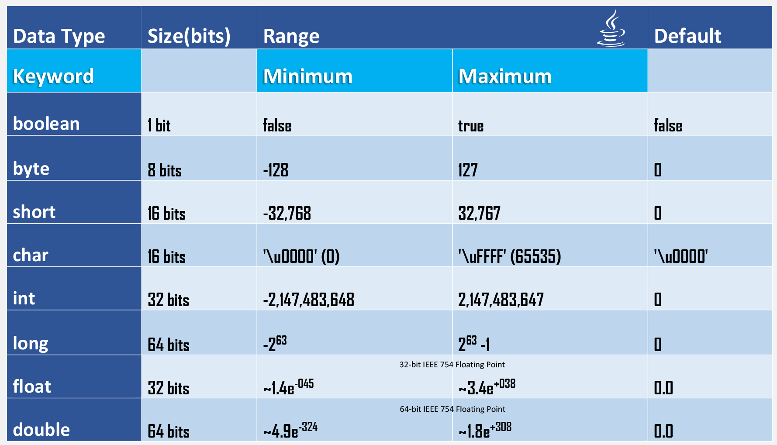
Ranges of Numeric Primitives:

Slide 12
Value Assignments
char a = 0x892; // hexadecimal literal
char b = 982; // int literal
char c = (char)70000; // The cast is required; 70000 is // out of char range
char d = (char) -98; // Ridiculous, but legal
char e = -29; // Possible loss of precision; needs a cast
char f = 70000 // Possible loss of precision; needs a cast
char c = '\"'; // A double quote
char d = '\n'; // A newline

Slide 13
Basic Mathematical Operators
* / % + - are the mathematical operators
*/ % have a higher precedence than + or –
double myVal = a + b % d – c * d / b;
Is the same as:
double myVal = (a + (b % d)) – ((c * d) / b);
int x = 7; // literal assignment
int y = x + 2; // assignment with an expression
// (including a literal)
int z = x * y; // assignment with an expression
byte b = 27;
byte b = x;

Slide 14
Basic Mathematical Operators
Narrowing requires an explicit cast:
byte a = 3; // No problem, 3 fits in a byte
byte b = 8; // No problem, 8 fits in a byte
byte c = b + c; // Should be no problem, sum of the two bytes
// fits in a byte
byte c = (byte) (a + b);
int a = 100;
long b = a; // Implicit cast, an int value always fits in a long
float a = 100.001f;
int b = (int)a; // Explicit cast, the float could lose info Integer values
double d = 100L; // Implicit cast
int x = 3957.229; // illegal

Slide 15
Basic Mathematical Operators
Auto Widening flows:
byte -> short -> int -> long -> double
byte -> short -> int -> float
char -> int -> long -> double
byte -> short -> int -> float -> double
char -> int -> float -> double

Slide 16
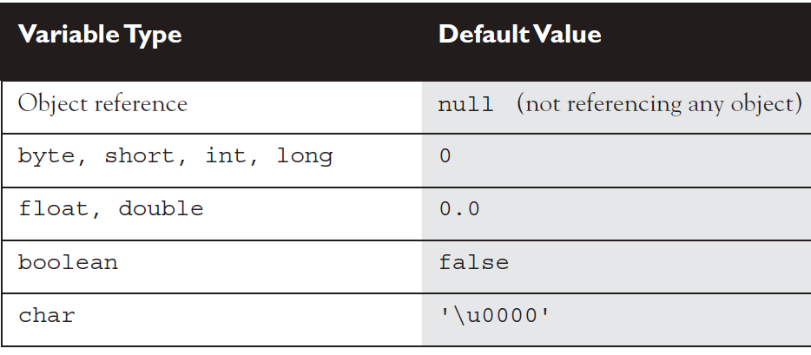
Default Values

Slide 17
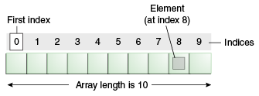
Arrays
An array is a list of similar things
An array has a fixed:
name
type
length
These must be declared when the array is created.
Arrays sizes cannot be changed during the execution of the code
Arrays always be an object on the heap

Slide 18
Constants
In Java constants are variables whose values, once assigned, cannot be changed. You declare a constant by using the keyword final. Here are examples of constants or final variables.
final int ROW_COUNT = 50;
final boolean ALLOW_USER_ACCESS = true;

Slide 19
Declaring Arrays
int[] key; // brackets before name (recommended)
int key []; // brackets after name (legal but less readable)
// spaces between the name and [] legal, but bad
int myArray[]; (Declaration)
int[5] scores; // not okey..
Construction: myArray to be an array of integers
myArray = new int[8];
(sets up 8 integer-sized spaces in memory, labelled myArray[0] to myArray[7])
int myArray[] = new int[8];
combines the two statements in one line

Slide 20
Assigning Values
You can create and initialise in one step:
int myArray[] = {3, 6, 3, 1, 6, 3, 4, 1};
myArray = {3, 6, 3, 1, 6, 3, 4, 1}; // not okey
myArray = new int[] {3, 6, 3, 1, 6, 3, 4, 1}; // okey
int[] carList = new int[]; // Will not compile; needs a size
int[] carList = new int[] {3, 6, 3, 1, 6, 3, 4, 1} ; // what u say?
You can refer to the array elements by index to store values in them.
myArray[0] = 3;
myArray[1] = 6;
myArray[2] = 3;

Slide 21
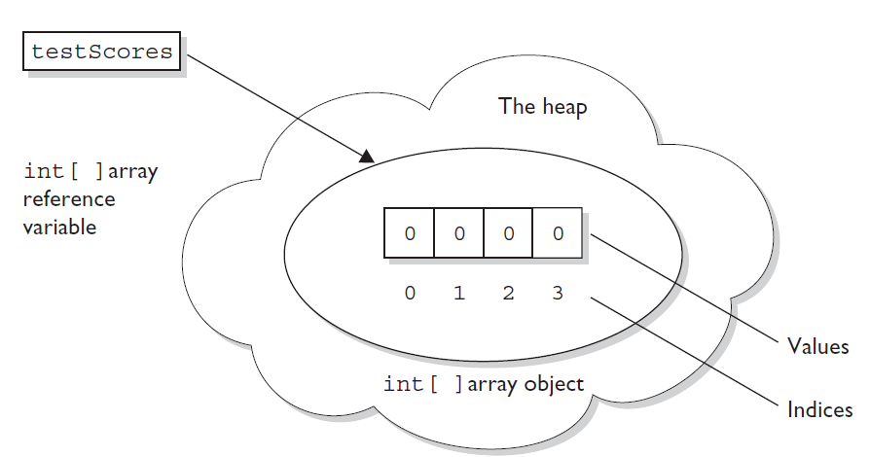
Assigning Values
int[] testScores; // Declares the array of ints
testScores = new int[4]; // constructs an array and assigns it // to the testScores variable

Slide 22
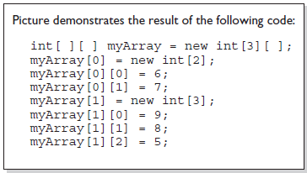
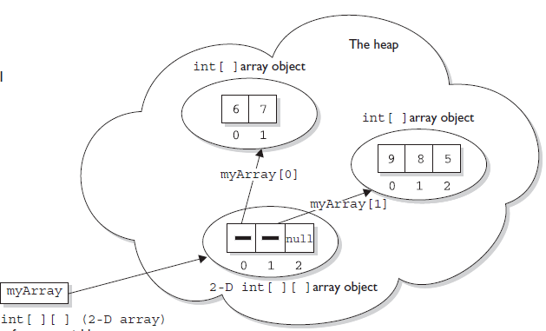
Assigning Values

Slide 23
Iterating Through Arrays
for loops are useful when dealing with arrays
for (int i = 0; i < myArray.length; i++)
{
myArray[i] = getsomevalue();
}

Slide 24
Statements & Blocks
A simple statement is a command terminated by a semi-colon
name = “Fred”;
A block is a compound statement enclosed in curly brackets:
{
name1 = “Fred”; name2 = “Bill”;
}
Blocks may contain other blocks

Slide 25
Flow of Control
Java executes one statement after the other in the order they are written
Many Java statements are flow control statements:
Alternation: if, if else, switch
Looping: for, while do while
Escapes: break, continue, return

Slide 26
If – The Conditional Statement
The if statement evaluates an expression and if that evaluation is true then the specified action is taken.
if ( x < 10 ) x = 10;
If the value of x is less than 10, make x equal to 10
It could have been written:
if ( x < 10 )
x = 10;
Or alternatively:
if ( x < 10 ) { x = 10; }

Slide 27
Relational Operators
==
!=
>=
Equal (careful)
Not equal
Greater than or equal
<=
>
<
Less than or equal
Greater than
Less than

Slide 28
If… else
The if … else statement evaluates an expression and performs one action if that evaluation is true or a different action if it is false.
if (x != oldx) {
System.out.print(“x was changed”);
}
else {
System.out.print(“x is unchanged”);
}

Slide 29
Nested if … else
if ( myVal > 100 )
{
if ( remainderOn == true)
{
myVal = mVal % 100;
}
else
{
myVal = myVal / 100.0;
}
}
else
{
System.out.print(“myVal is in range”);
}

Slide 30
else if
Useful for choosing between alternatives:
if ( n == 1 ) {
// execute code block #1
}
else if ( j == 2 ) {
// execute code block #2
}
else {
// if all previous tests have failed, execute code block #3
}

Slide 31
A Warning…
WRONG!
if( i == j )
if ( j == k )
System.out.print (“i equals k”);
else
System.out.print (“i is not equal to j”);
CORRECT!
if( i == j ) {
if ( j == k )
System.out.print (“i equals k”);
}
else
System.out.print (“i is not equal to j”); // Correct!

Slide 32
The switch Statement
switch ( n ) {
case 1:
// execute code block #1
break;
case 2:
// execute code block #2
break;
default: // if all previous tests fail then
//execute this code block
break;
}

Slide 33
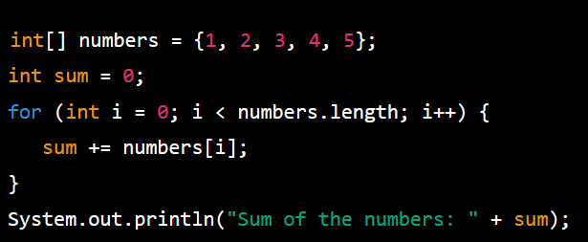
The for loop
In this example, we have an array of integers, and we want to find the sum of all the elements in the array. We use a for loop to iterate through each element in the array and add it to a running sum variable.

Slide 34
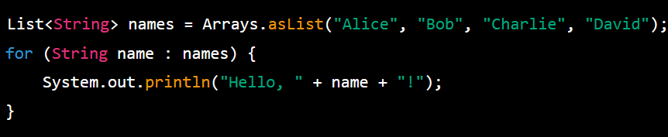
Foreach Loop
In this example, we have a list of strings, and we want to print a greeting message for each name in the list. We use a foreach loop to iterate through each element in the list and print a message using that element.

Slide 35
while loops
while(response == 1) {
System.out.print( “ID =” + userID[n]);
n++;
response = readInt( “Enter “);
}
What is the minimum number of times the loop is executed?
What is the maximum number of times?

Slide 36
do {… } while loops
do {
System.out.print( “ID =” + userID[n] );
n++;
response = readInt( “Enter ” );
} while (response == 1);
What is the minimum number of times the loop is executed?
What is the maximum number of times?

Slide 37
Break
A break statement causes an exit from the innermost containing while, do, for or switch statement.
for ( int i = 0; i < maxID, i++ ) {
if ( userID[i] == targetID ) {
index = i;
break;
}
} // program jumps here after break

Slide 38
Continue
Can only be used with while, do or for. The continue statement causes the innermost loop to start the next iteration immediately
for ( int i = 0; i < maxID; i++ ) {
if ( userID[i] != -1 ) continue;
System.out.print( “UserID ” + i + “ :” + userID);
}

Slide 39

Wrapper Classes in Java
In Java, a wrapper class is a class that provides an object representation of a primitive data type.
Wrapper classes are used to convert primitive data types into objects, which allows them to be used in situations where objects are required, such as in collections and generic classes.

Slide 40
Wrapper Classes in Java
Here are the wrapper classes for the eight primitive data types in Java:
Byte: Represents a byte value (-128 to 127)
Short: Represents a short value (-32,768 to 32,767)
Integer: Represents an integer value (-2^31 to 2^31-1)
Long: Represents a long value (-2^63 to 2^63-1)
Float: Represents a floating-point value (approximately ±1.4E-45 to ±3.4E+38)
Double: Represents a double value (approximately ±4.9E-324 to ±1.8E+308)
Boolean: Represents a Boolean value (true or false)
Character: Represents a character value (Unicode character set)

Slide 41
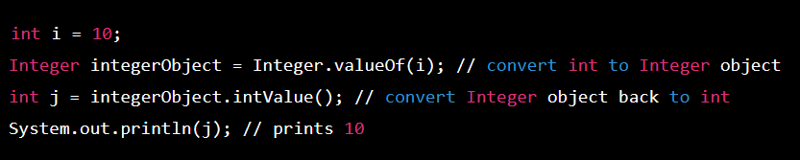
How to use the Integer Wrapper class
Wrapper classes are often used when working with collections, because collections can only store objects, not primitive types.
For example, if you want to store a list of integers in a collection, you can use the Integer wrapper class to convert the primitive int type into an object.
Here's an example of how to use the Integer wrapper class:

Slide 42
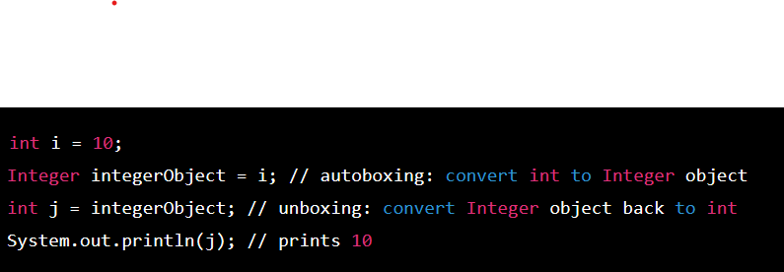
Example of Autoboxing and Unboxing
In Java 5 and later, autoboxing and unboxing feature was introduced which allows automatic conversion between primitive types and their corresponding wrapper classes.
This means you can write code that uses primitive types, and the Java compiler will automatically convert them to their corresponding wrapper classes as needed.
Here's an example of autoboxing and unboxing:

Slide 43
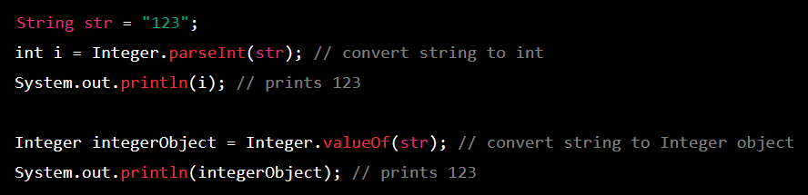
The use of Wrapper Classes in Java: Complex Examples
Here are a few complex examples that demonstrate the use of wrapper classes in Java:
1. Converting Strings to Integers using the Integer Wrapper Class:
In this example, we have a string "123" and we want to convert it to an integer. We use the Integer wrapper class to do this conversion in two ways: first by using the parseInt method, which returns an int, and second by using the valueOf method, which returns an Integer object.

Slide 44
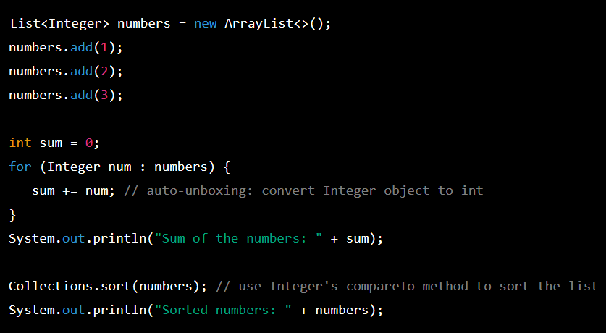
The use of Wrapper Classes in Java: Complex Examples
In this example, we have a list of Integer objects, and we use them with generics.
We add some integers to the list and then use a foreach loop to iterate through each element and add them to a running sum variable.
When we access the Integer objects in the list, they are automatically unboxed to their primitive int values.
We also use the Collections.sort method to sort the list, which works because the Integer class implements the Comparable interface and provides a compareTo method.

Slide 45
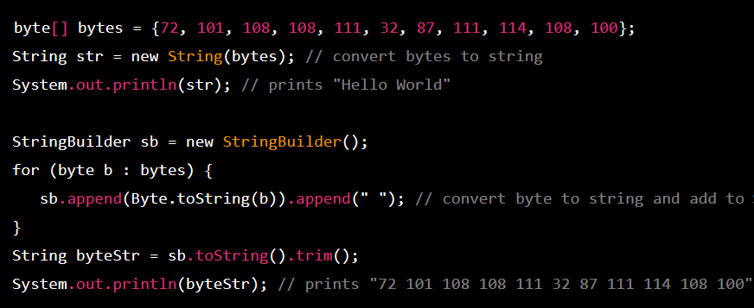
The use of Wrapper Classes in Java: Complex Examples
3. Converting Bytes to Strings using the Byte Wrapper Class:
In this example, we have an array of bytes, and we want to convert it to a string. We use the String constructor that takes a byte array to do this conversion.
We also use the Byte wrapper class to convert each byte to a string and add it to a StringBuilder. We then convert the StringBuilder to a string and print it, which gives us a space-separated list of byte values.

Slide 46
Generics in JAVA
Generics in Java is a feature that allows classes, interfaces, and methods to be parameterized with one or more types.
In other words, it allows you to define a class or method that can work with different types of data, without the need to create a separate version of the class or method for each data type.
The syntax for declaring a generic type is to use angle brackets (<>) and a placeholder name (usually a single uppercase letter) to represent the type parameter.

Slide 47
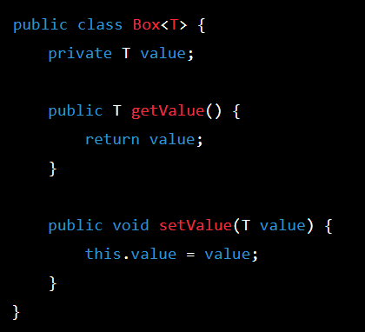
Generics in JAVA
For example, the following code declares a generic class called Box that can hold any type of object:
In this example, the type parameter T is used as a placeholder for the actual type that will be used when the class is instantiated.

Slide 48
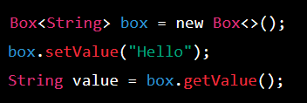
Generics in JAVA
For example, to create a Box that holds strings, we can use the following code:
In this code, the <String> part after Box indicates that we are using the Box class with the String type parameter.
Using generics in Java provides several benefits, such as improved type safety, code reusability, and reduced code duplication. It also makes code easier to read and understand, as it provides a clear indication of what types are expected and returned by a given class or method.

Slide 49
Thank You

